Slide 1

50.039 Theory and Practice of Deep Learning W6-S1 Times Series Data and Recurrent Neural Networks
Matthieu De Mari

Slide 2
About this week (Week 6)
What is a time series dataset?
How to analyze a time series, and what are typical deep learning models capable of doing that?
What is history, and why is it needed for time series predictions?
What is a good history length?
What is memory and how to represent it in a Neural Network model?
How to implement a first vanilla Recurrent Neural Network model?
Why is the vanishing gradient problem prominent in RNNs?

Slide 3
About this week (Week 6)
What is the LSTM model?
What is the GRU model?
What are one-to-one, one-to-many, many-to-one and many-to-many models?
What are some typical application examples of these?
What is a Seq2Seq model?
What are encoder and decoder architectures?
What is an autoregressive RNN?

Slide 4
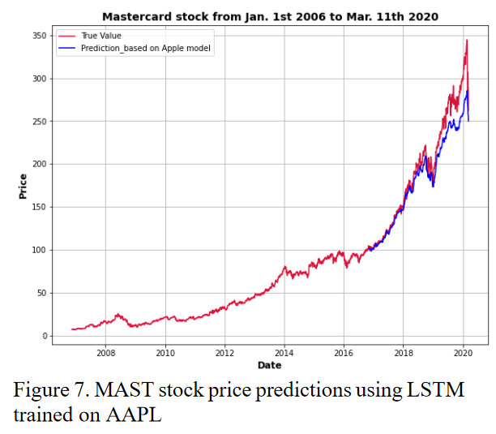
Time series dataset
Definition (time series dataset):
A time series dataset is a sequence of data points that are collected over time, typically at regular intervals.
Time series data can be used to study how a particular variable changes over time, with many applications as
Stock prices,
Weather patterns,
Etc.
Data points are usually ordered chronologically, with each data point representing the value of the variable at a specific point in time.

Slide 5
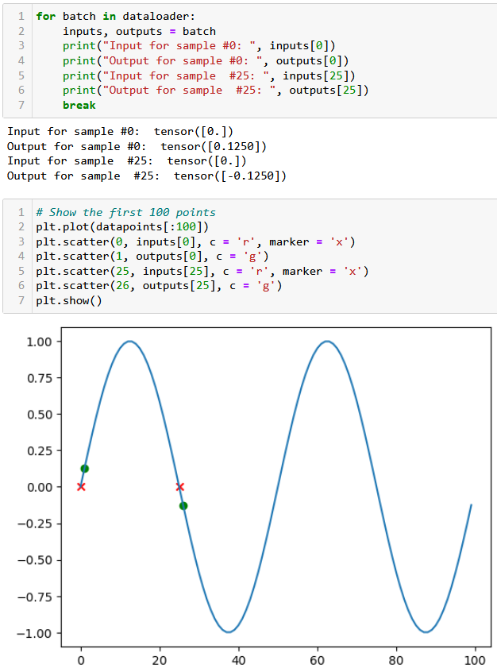
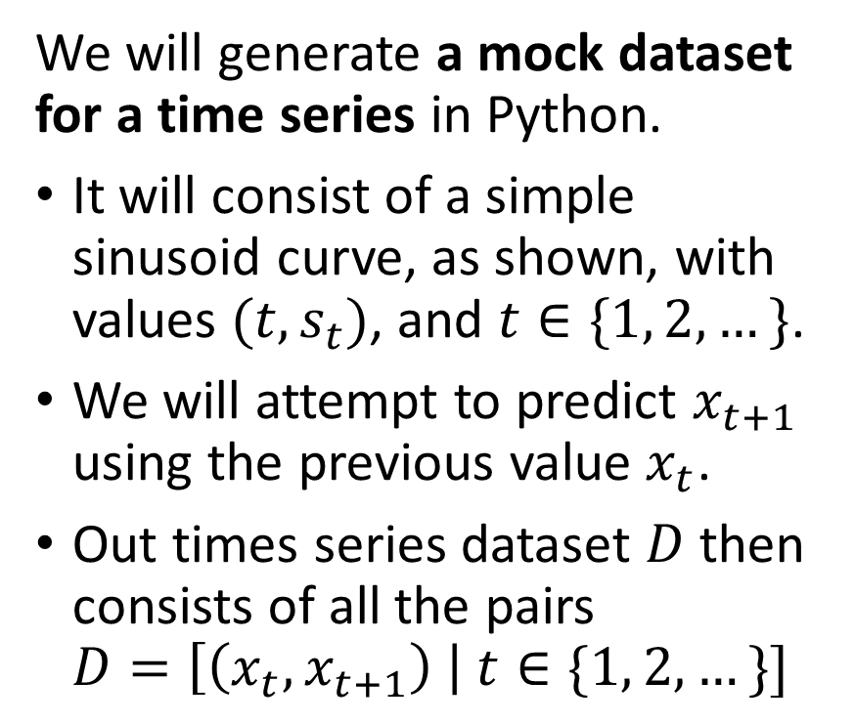
A mock dataset
We will generate a mock dataset for a time series in Python.
It will consist of a simple sinusoid curve, as shown, with values $(t,s_{t})$, and $t∈\{1, 2,…\}$.
We will attempt to predict $x_{t+1}$ using the previous value $x_{t}$.
Out times series dataset $D$ then consists of all the pairs $D=\left[\left(x_{t}, x_{t+1}\right) \right| t∈\{1, 2, …\}]$

Slide 6
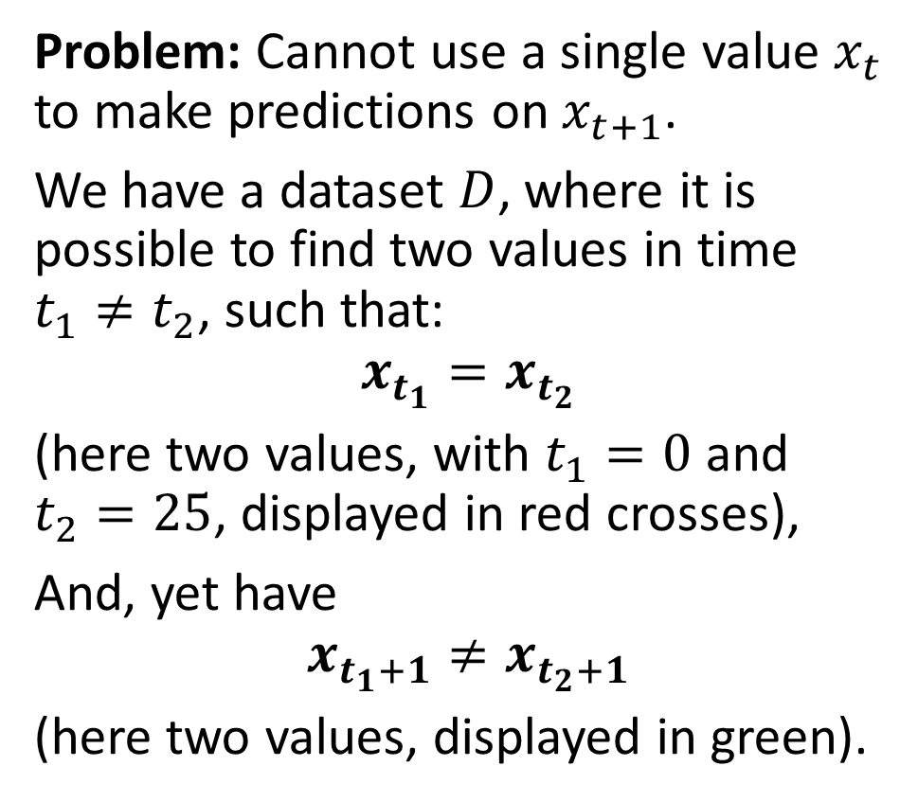
A mock dataset
Problem: Cannot use a single value $x_{t}$ to make predictions on $x_{t+1}$.
We have a dataset $D$, where it is possible to find two values in time $t_{1}≠t_{2}$, such that:
$$x_{t_{1}}=x_{t_{2}}$$ (here two values, with $t_{1}=0$ and $t_{2}=25$, displayed in red crosses),
And, yet have
$$x_{t_{1}+1}≠x_{t_{2}+1}$$
(here two values, displayed in green).

Slide 7
Typical methods for analysing a time series
Typical methods for analysing a time series include
Descriptive statistics: calculating basic summary statistics for the time series (mean, median, variance, etc.). These statistics can provide insights into the central tendency, variability, and distribution of the data.
Visual inspection: Plotting the time series data helps identify patterns, trends, and outliers in the data.

Slide 8
Typical methods for analysing a time series
Decomposition: Time series data often exhibit trends, seasonal patterns, and irregular fluctuations.
Decomposition is a method for separating these components and analysing them separately
Common methods for decomposition include additive and multiplicative decomposition.
(These are out-of-scope.)

Slide 9
A quick word about decomposition
Decomposition separates the time series data into different components that capture distinct aspects of the data, expressing it as the sum of several underlying components, each with its own distinct pattern, e.g.:
Trend: This component represents the long-term changes or fluctuations in the data over time. It is typically modelled as a smooth curve that captures the overall direction of the time series.
Seasonal: This component captures the regular, periodic fluctuations in the data that occur over fixed periods of time, such as daily, weekly, or monthly. It is often modelled as a set of repeating patterns that correspond to the seasonal cycles.
Residual: This component represents the random or irregular fluctuations in the data that are not explained by the trend or seasonal components. It is often modelled as a series of random noise or white noise.

Slide 10
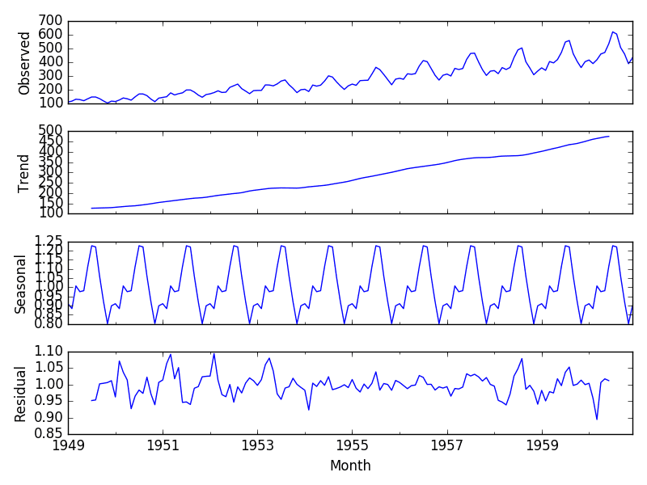
A quick word about decomposition
Decomposition separates a time series into trend (long-term changes), seasonal (periodic fluctuations), and residual (random fluctuations) components.
Trend is a smooth curve, seasonal is a set of repeating patterns, and residual is a series of random noise.

Slide 11
Typical methods for analysing a time series
Time series models: Statistical models used to describe the underlying processes that generate the time series data.
Time series models can be used for forecasting future values, identifying important predictors, and understanding the relationships among variables.
ML models: autoregressive integrated moving average (ARIMA) models, exponential smoothing models, state space models, etc.
(These are out-of-scope.)

Slide 12
Typical methods for analysing a time series
Time series models: Statistical models used to describe the underlying processes that generate the time series data.
Time series models can be used for forecasting future values, identifying important predictors, and understanding the relationships among variables.
DL models: using neural networks as predictors, to predict the next value for a time series variable given a history as input.
(to be investigated!)

Slide 13
A mock dataset
Problem: Cannot use a single value $x_{t}$ to make predictions on $x_{t+1}$.
We have a dataset $D$, where it is possible to find two values in time $t_{1}≠t_{2}$, such that:
$$x_{t_{1}}=x_{t_{2}}$$ (here two values, with $t_{1}=0$ and $t_{2}=25$, displayed in red crosses),
And, yet have
$$x_{t_{1}+1}≠x_{t_{2}+1}$$
(here two values, displayed in green).

Slide 14
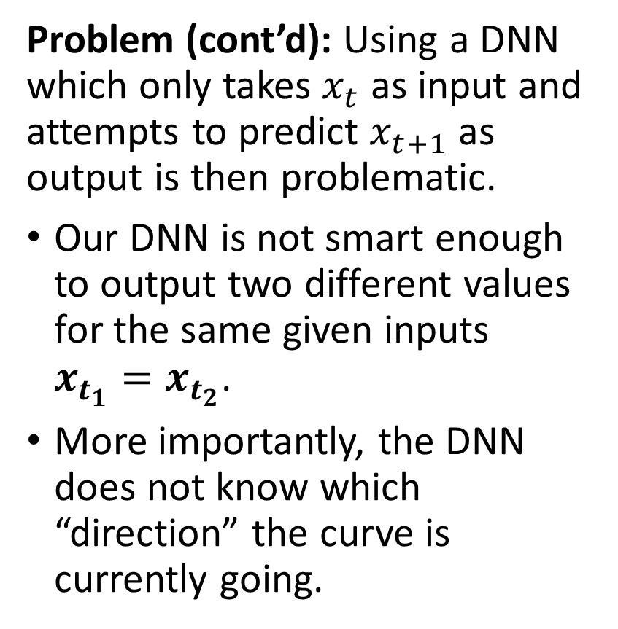
A mock dataset
Problem: Cannot use a single value $x_{t}$ to make predictions on $x_{t+1}$.
We have a dataset $D$, where it is possible to find two values in time $t_{1}≠t_{2}$, such that:
$$x_{t_{1}}=x_{t_{2}}$$ (here two values, with $t_{1}=0$ and $t_{2}=25$, displayed in red crosses),
And, yet have
$$x_{t_{1}+1}≠x_{t_{2}+1}$$
(here two values, displayed in green).
Problem (cont’d): Using a DNN which only takes $x_{t}$ as input and attempts to predict $x_{t+1}$ as output is then problematic.
Our DNN is not smart enough to output two different values for the same given inputs $x_{t_{1}}=x_{t_{2}}$.
More importantly, the DNN does not know which “direction” the curve is currently going.

Slide 15
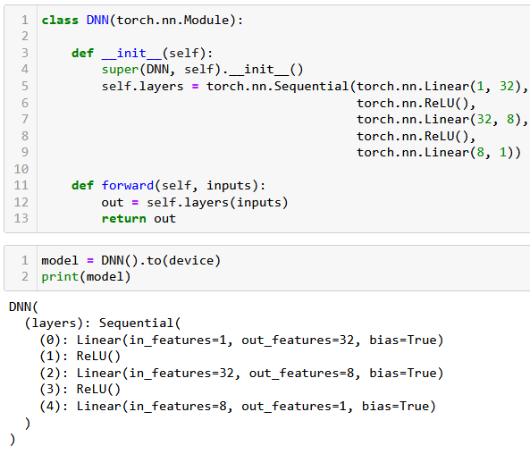
Using a simple DNN to predict
Let us try it, anyway: Let us try and define a simple DNN:
3 Linear Layers + ReLU,
No ReLU on final layer,
Number of inputs = 1,
Number of outputs = 1,
Hidden layers sizes: 32 and 8.

Slide 16
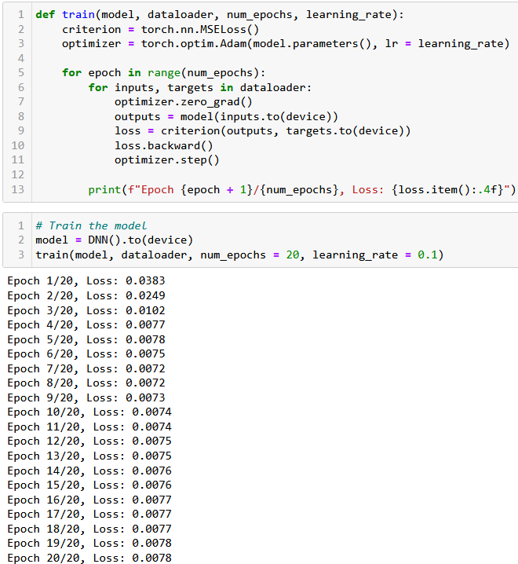
Using a simple DNN to predict
Let us try it, anyway: Let us try and define a simple DNN:
3 Linear Layers + ReLU,
No ReLU on final layer,
Number of inputs = 1,
Number of outputs = 1,
Hidden layers sizes: 32 and 8.
Simple trainer function, and seems to train, but is it good?

Slide 17
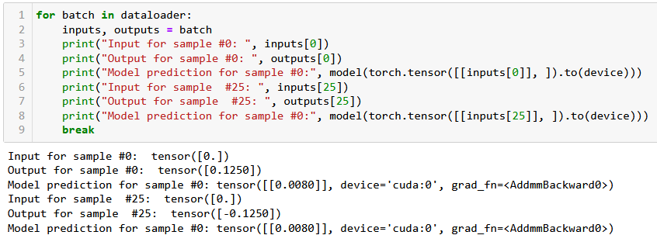

Using a simple DNN to predict
This low loss obtained after training does not mean much…
The model cannot learn to predict correctly: it is not smart enough to output two different values for the same given inputs $x_{t_{1}}=x_{t_{2}}$.
Also, it needs to know which “direction” the curve is currently going.

Slide 18
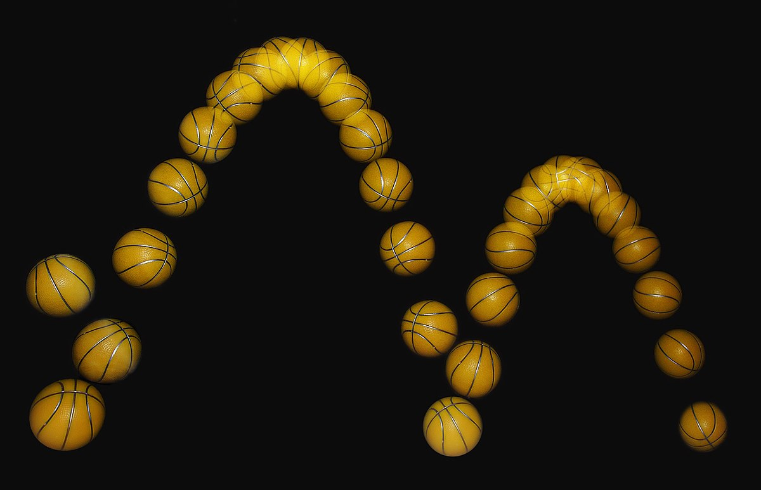
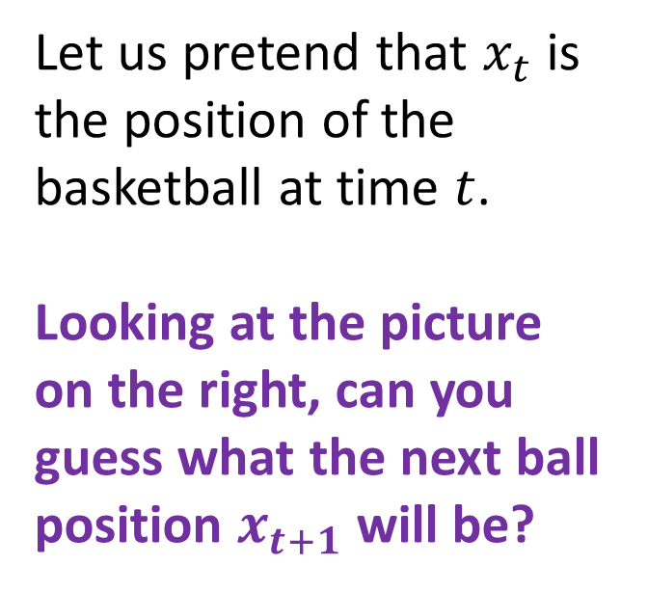
A visual example for the need of “direction”
Let us pretend that $x_{t}$ is the position of the basketball at time $t$.
Looking at the picture on the right, can you guess what the next ball position $x_{t+1}$ will be?
????

Slide 19
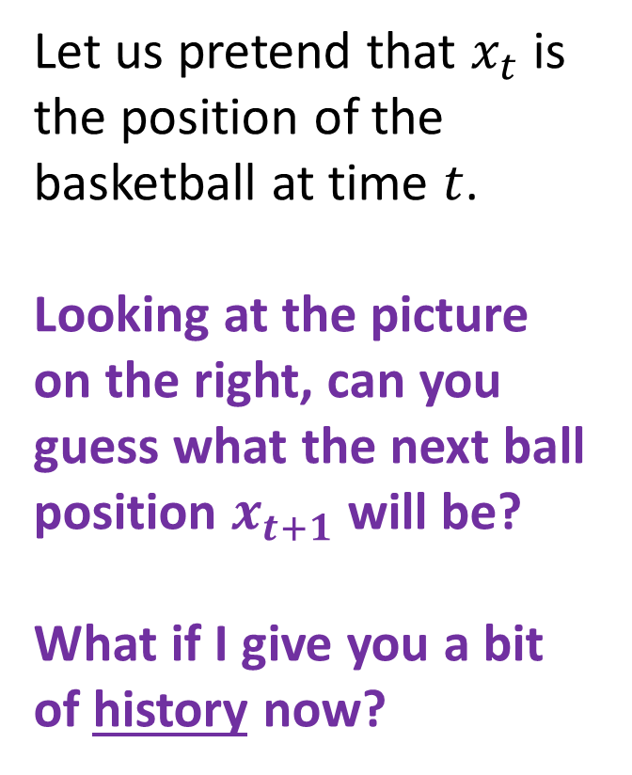
A visual example for the need of “direction”
Let us pretend that $x_{t}$ is the position of the basketball at time $t$.
Looking at the picture on the right, can you guess what the next ball position $x_{t+1}$ will be?
What if I give you a bit of history now?
????

Slide 20
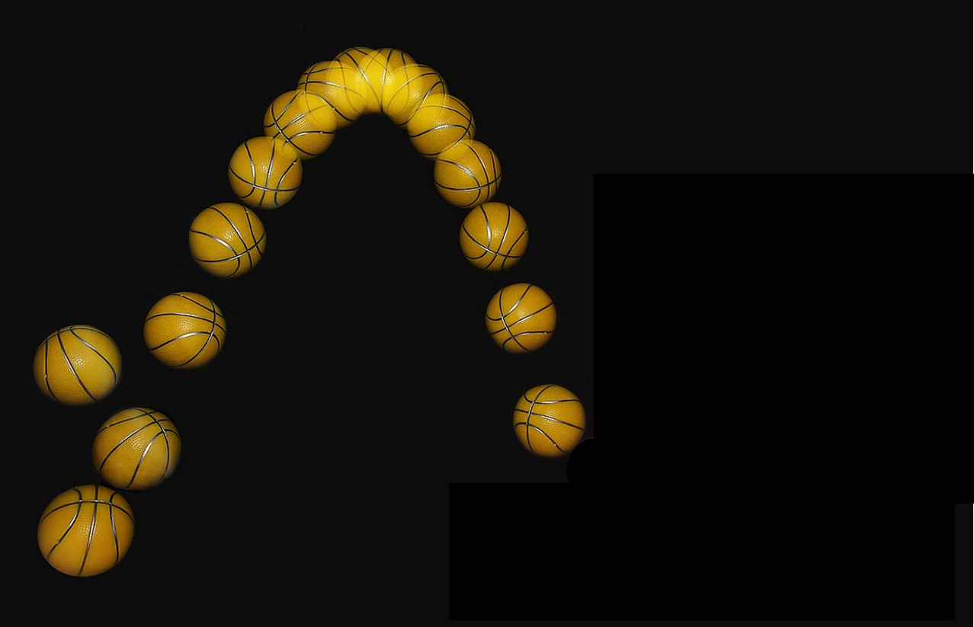
A visual example for the need of “direction”
Definition (history):
History refers to the past observations or values of the time series up to a certain point in time.
It provides information about the patterns and trends of the data over time, which can be used to make predictions and identify important factors that influence the time series.
E.g., predicting a stock price, requires to know the history of the stock prices to understand its behaviour.

Slide 21
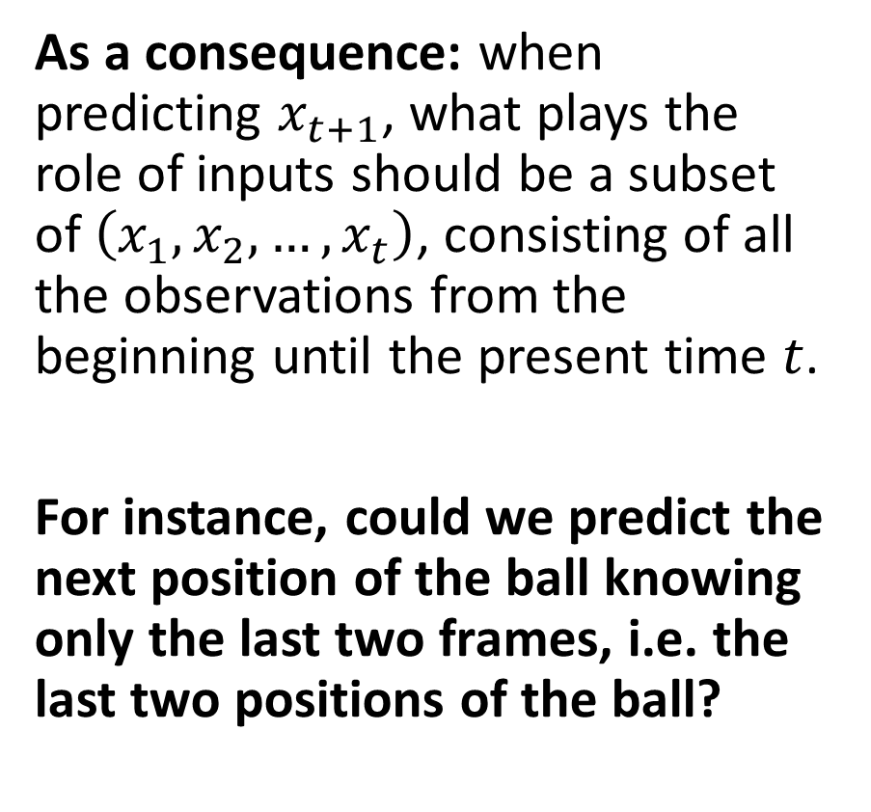
A visual example for the need of “direction”
As a consequence: when predicting $x_{t+1}$, what plays the role of inputs should be a subset of $\left(x_{1}, x_{2}, …, x_{t}\right)$, consisting of all the observations from the beginning until the present time $t$.
For instance, could we predict the next position of the ball knowing only the last two frames, i.e. the last two positions of the ball?

Slide 22
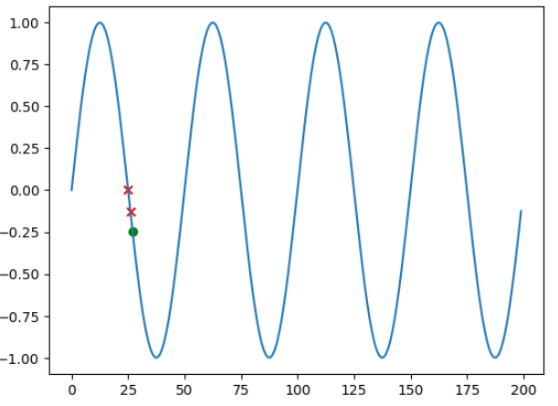
Lookback size
Definition (lookback size):
The number of past observations or values of a time series that are used to make a prediction is commonly referred to as the "lookback" or "window" size.
It is the length of the history that is used to inform the prediction of the next value in the time series.
In our example, the lookback size is simply 2.

Slide 23
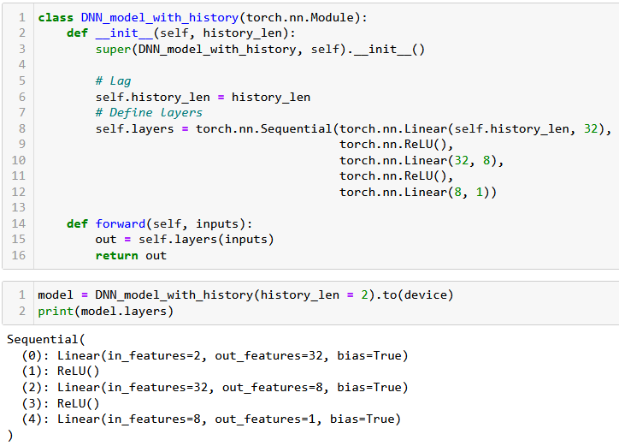
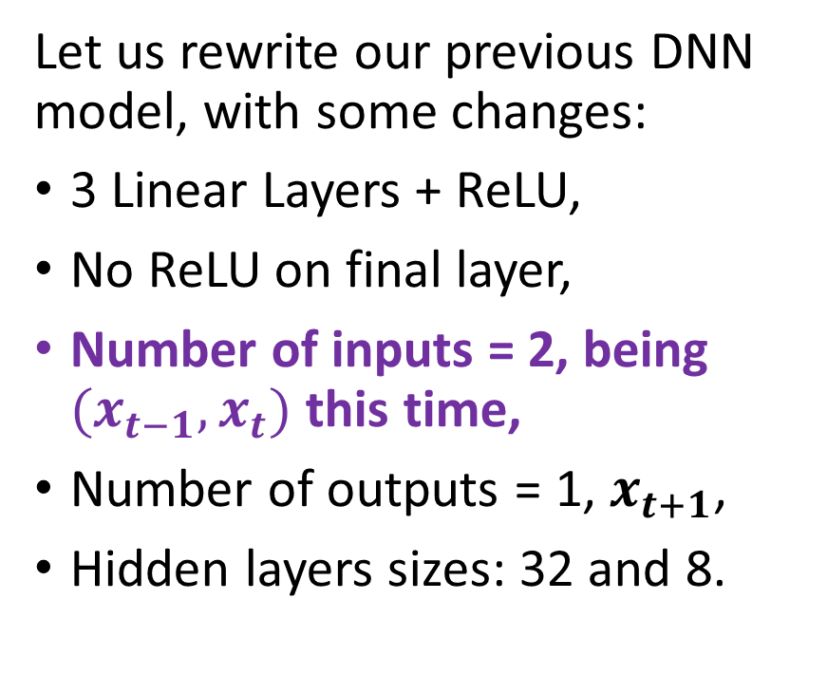
Using a simple DNN to predict
Let us rewrite our previous DNN model, with some changes:
3 Linear Layers + ReLU,
No ReLU on final layer,
Number of inputs = 2, being $(x_{t−1}, x_{t})$ this time,
Number of outputs = 1, $x_{t+1}$,
Hidden layers sizes: 32 and 8.

Slide 24
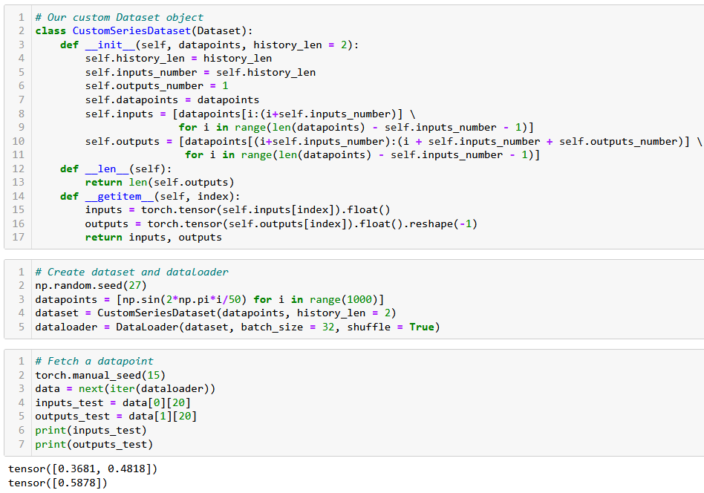
Reworking the Dataset to include history

Slide 25
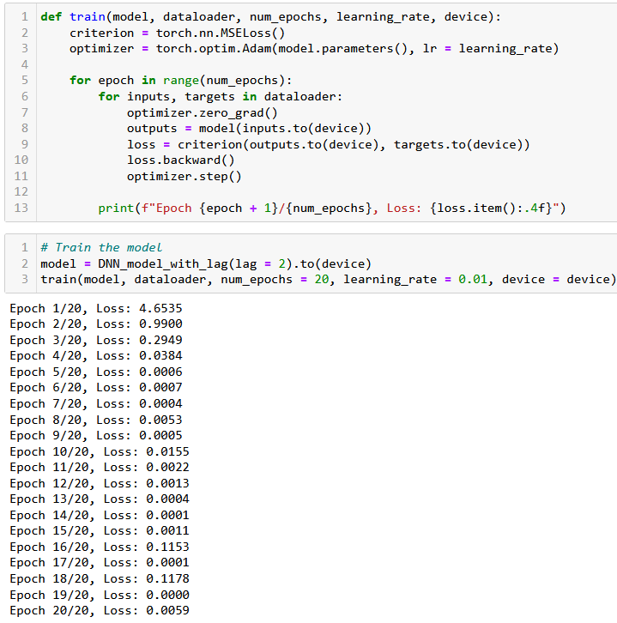
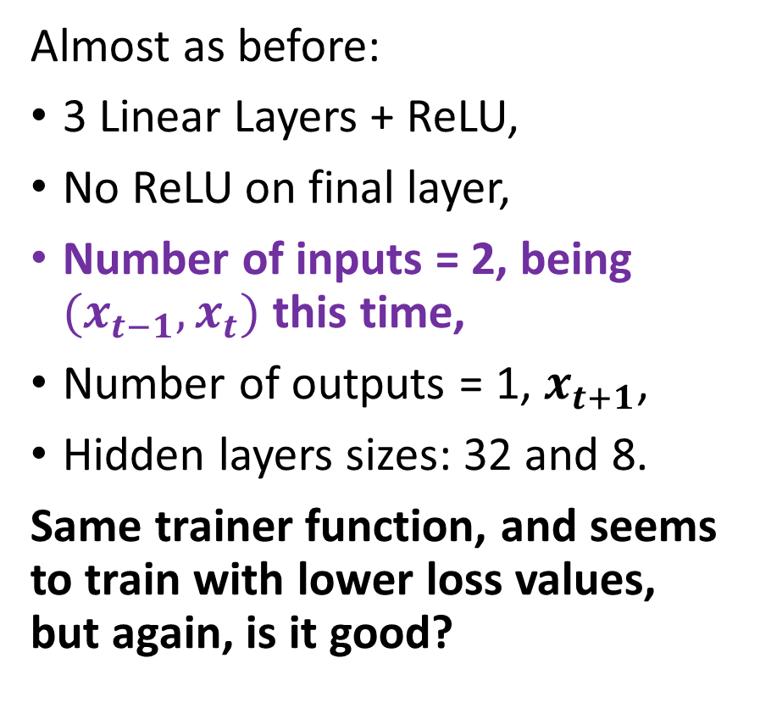
Using a simple DNN to predict
Almost as before:
3 Linear Layers + ReLU,
No ReLU on final layer,
Number of inputs = 2, being $(x_{t−1}, x_{t})$ this time,
Number of outputs = 1, $x_{t+1}$,
Hidden layers sizes: 32 and 8.
Same trainer function, and seems to train with lower loss values, but again, is it good?

Slide 26
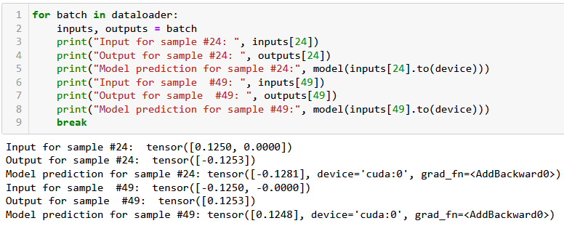

Using a simple DNN to predict
This time the predictor works, as we obtain the good prediction values.
In the example below, we had $x_{t_{1}}=x_{t_{2}}$, but $x_{t_{1}−1}≠x_{t_{2}−1}$.
This was good enough to help the DNN formulate two good different predictions $x_{t_{1}+1}$ and $x_{t_{2}+1}$.

Slide 27
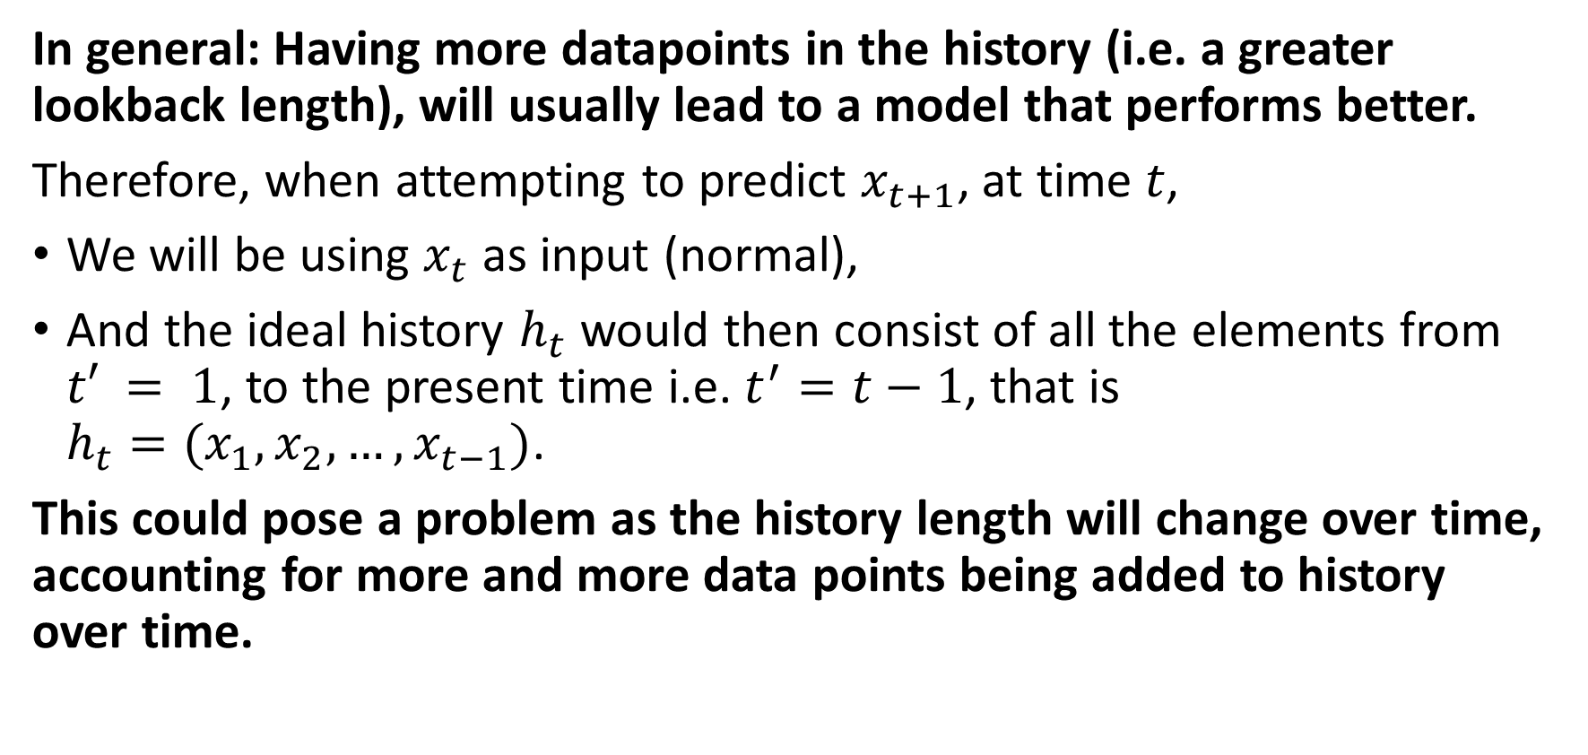
What is a good history length then?
In general: Having more datapoints in the history (i.e. a greater lookback length), will usually lead to a model that performs better.
Therefore, when attempting to predict $x_{t+1}$, at time $t$,
We will be using $x_{t}$ as input (normal),
And the ideal history $h_{t}$ would then consist of all the elements from $t′ = 1$, to the present time i.e. $t^{′}=t−1$, that is $h_{t}=(x_{1}, x_{2}, …, x_{t−1})$.
This could pose a problem as the history length will change over time, accounting for more and more data points being added to history over time.

Slide 28
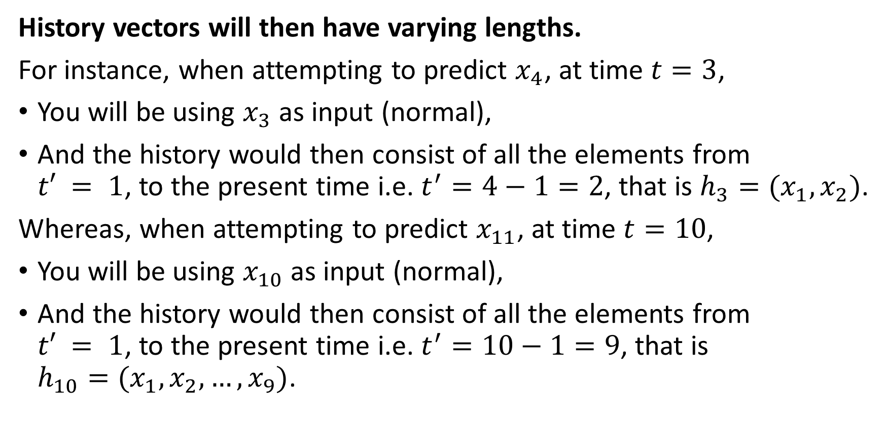
The problem of varying length
History vectors will then have varying lengths.
For instance, when attempting to predict $x_{4}$, at time $t=3$,
You will be using $x_{3}$ as input (normal),
And the history would then consist of all the elements from $t′ = 1$, to the present time i.e. $t^{′}=4−1=2$, that is $h_{3}=(x_{1}, x_{2})$.
Whereas, when attempting to predict $x_{11}$, at time $t=10$,
You will be using $x_{10}$ as input (normal),
And the history would then consist of all the elements from $t′ = 1$, to the present time i.e. $t^{′}=10−1=9$, that is $h_{10}=(x_{1},x_{2},…, x_{9})$.

Slide 29
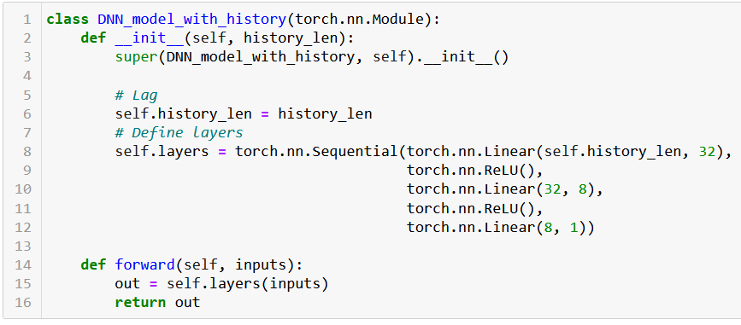
The problem of varying length
Problem: Variable history length cannot work with our current neural network because it requires fixed-length input sequences.

Slide 30
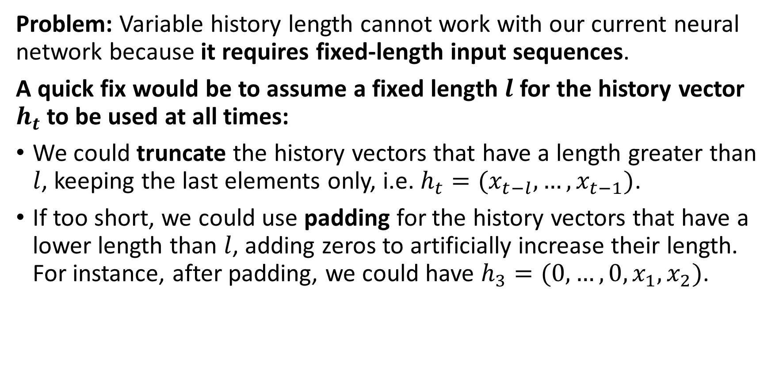
The problem of varying length
Problem: Variable history length cannot work with our current neural network because it requires fixed-length input sequences.
A quick fix would be to assume a fixed length $l$ for the history vector $h_{t}$to be used at all times:
We could truncate the history vectors that have a length greater than $l$, keeping the last elements only, i.e. $h_{t}=(x_{t−l},…,x_{t−1})$.
If too short, we could use padding for the history vectors that have a lower length than $l$, adding zeros to artificially increase their length. For instance, after padding, we could have $h_{3}=(0, …, 0, x_{1}, x_{2})$.

Slide 31
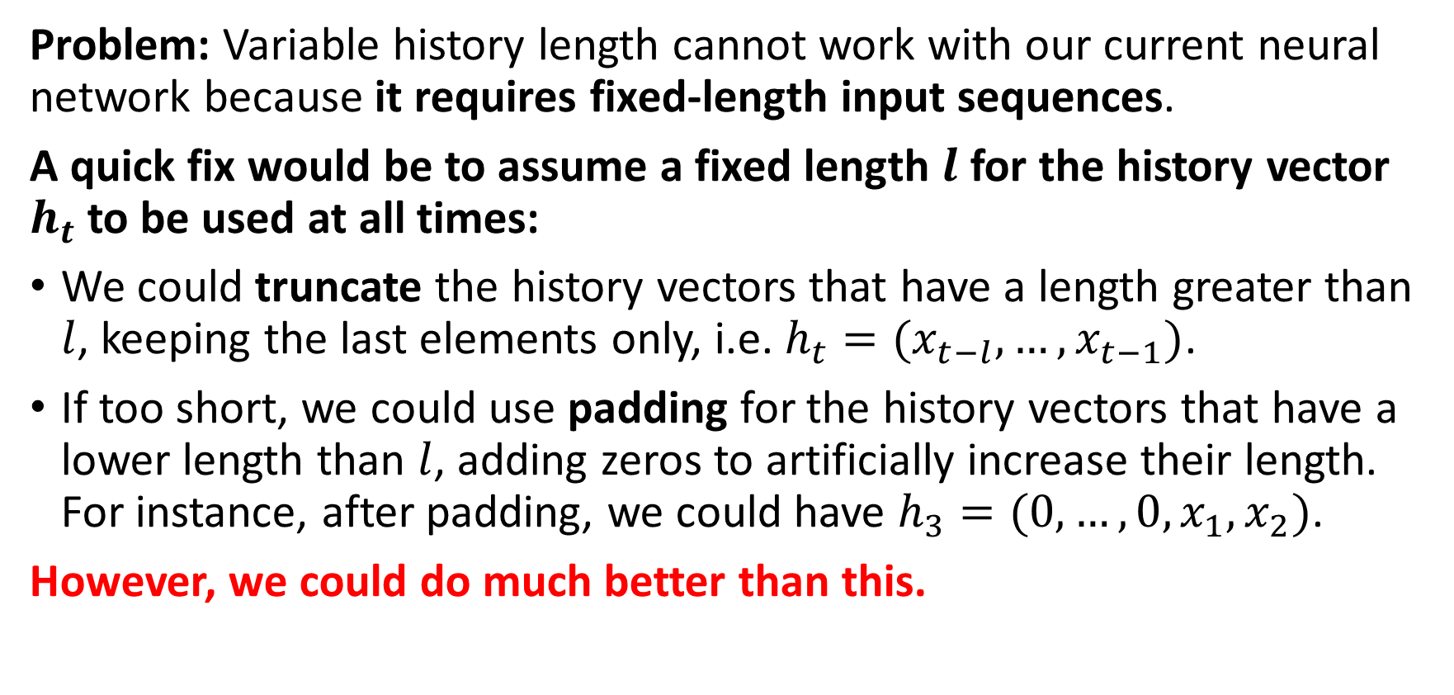
The problem of varying length
Problem: Variable history length cannot work with our current neural network because it requires fixed-length input sequences.
A quick fix would be to assume a fixed length $l$ for the history vector $h_{t}$to be used at all times:
We could truncate the history vectors that have a length greater than $l$, keeping the last elements only, i.e. $h_{t}=(x_{t−l},…,x_{t−1})$.
If too short, we could use padding for the history vectors that have a lower length than $l$, adding zeros to artificially increase their length. For instance, after padding, we could have $h_{3}=(0, …, 0, x_{1}, x_{2})$.
However, we could do much better than this.

Slide 32
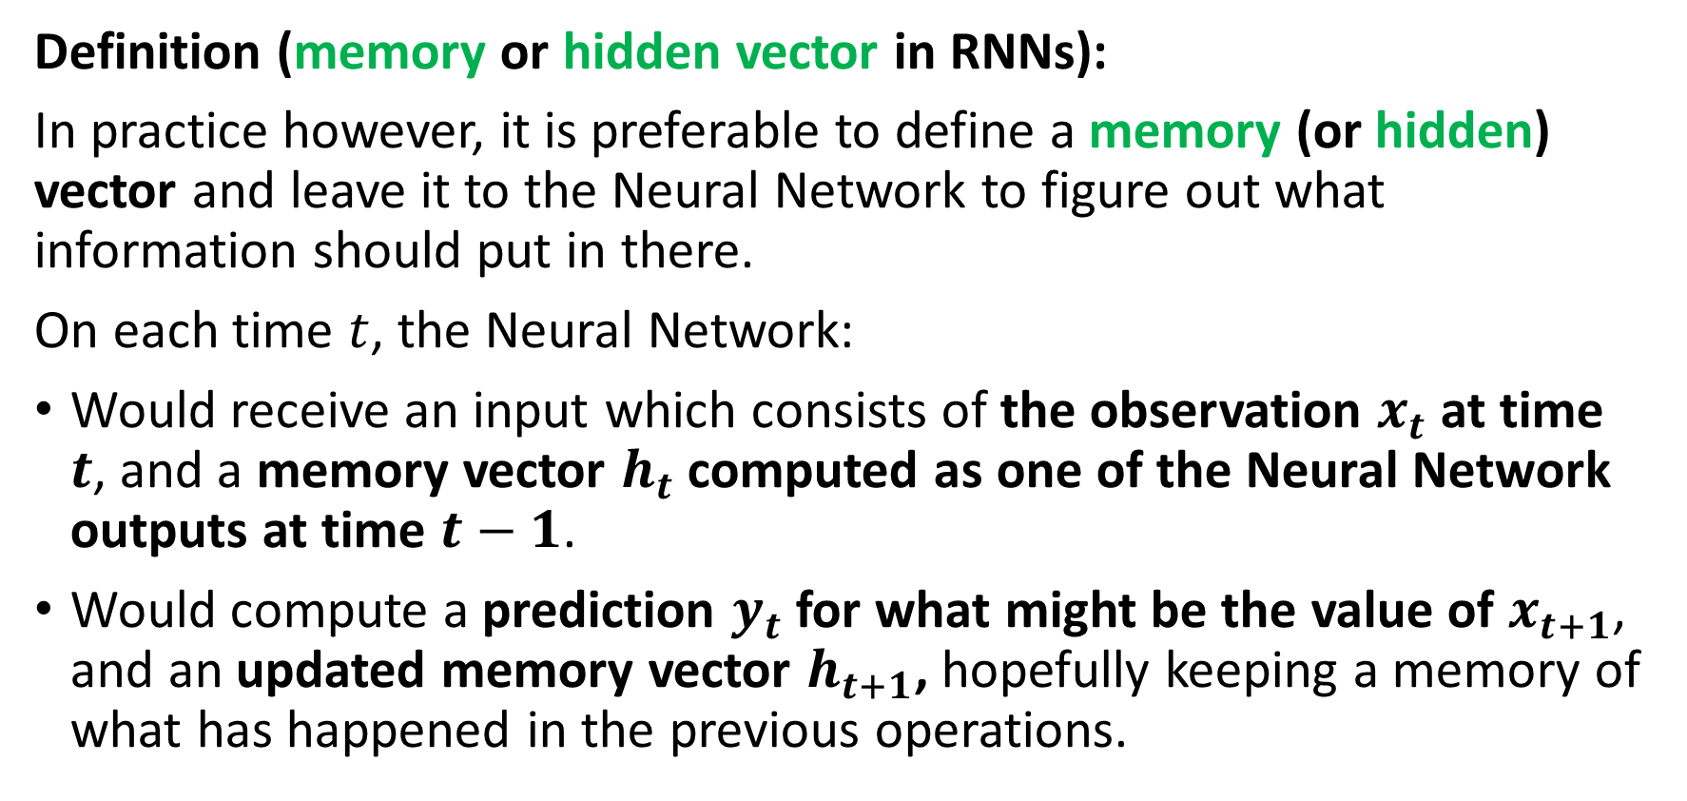
The need for memory
Definition (memory or hidden vector in RNNs):
In practice however, it is preferable to define a memory (or hidden) vector and leave it to the Neural Network to figure out what information should put in there.
On each time $t$, the Neural Network:
Would receive an input which consists of the observation $x_{t}$ at time $t$, and a memory vector $h_{t}$ computed as one of the Neural Network outputs at time $t−1$.
Would compute a prediction $y_{t}$ for what might be the value of $x_{t+1}$, and an updated memory vector $h_{t+1}$, hopefully keeping a memory of what has happened in the previous operations.

Slide 33


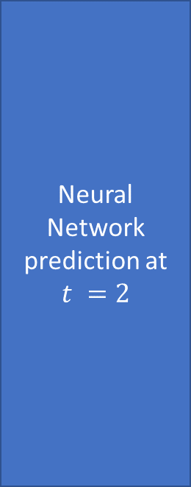
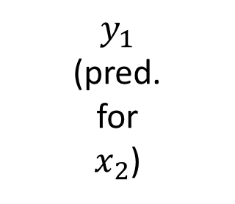

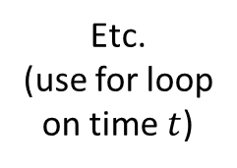



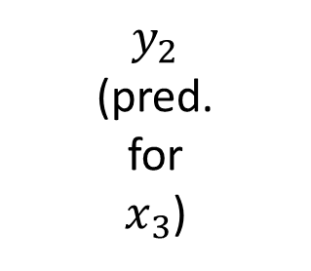
The need for memory
Neural Network prediction at $t = 1$
$$y_{1}$$
(pred. for $x_{2}$)
Neural Network prediction at $t =2$
$$y_{2}$$
(pred. for $x_{3}$)
$$x_{1}$$
$$x_{2}$$
Etc.
(use for loop on time $t$)
$$h_{0}=zeros(l)$$
$$h_{1}$$
$$h_{2}$$

Slide 34
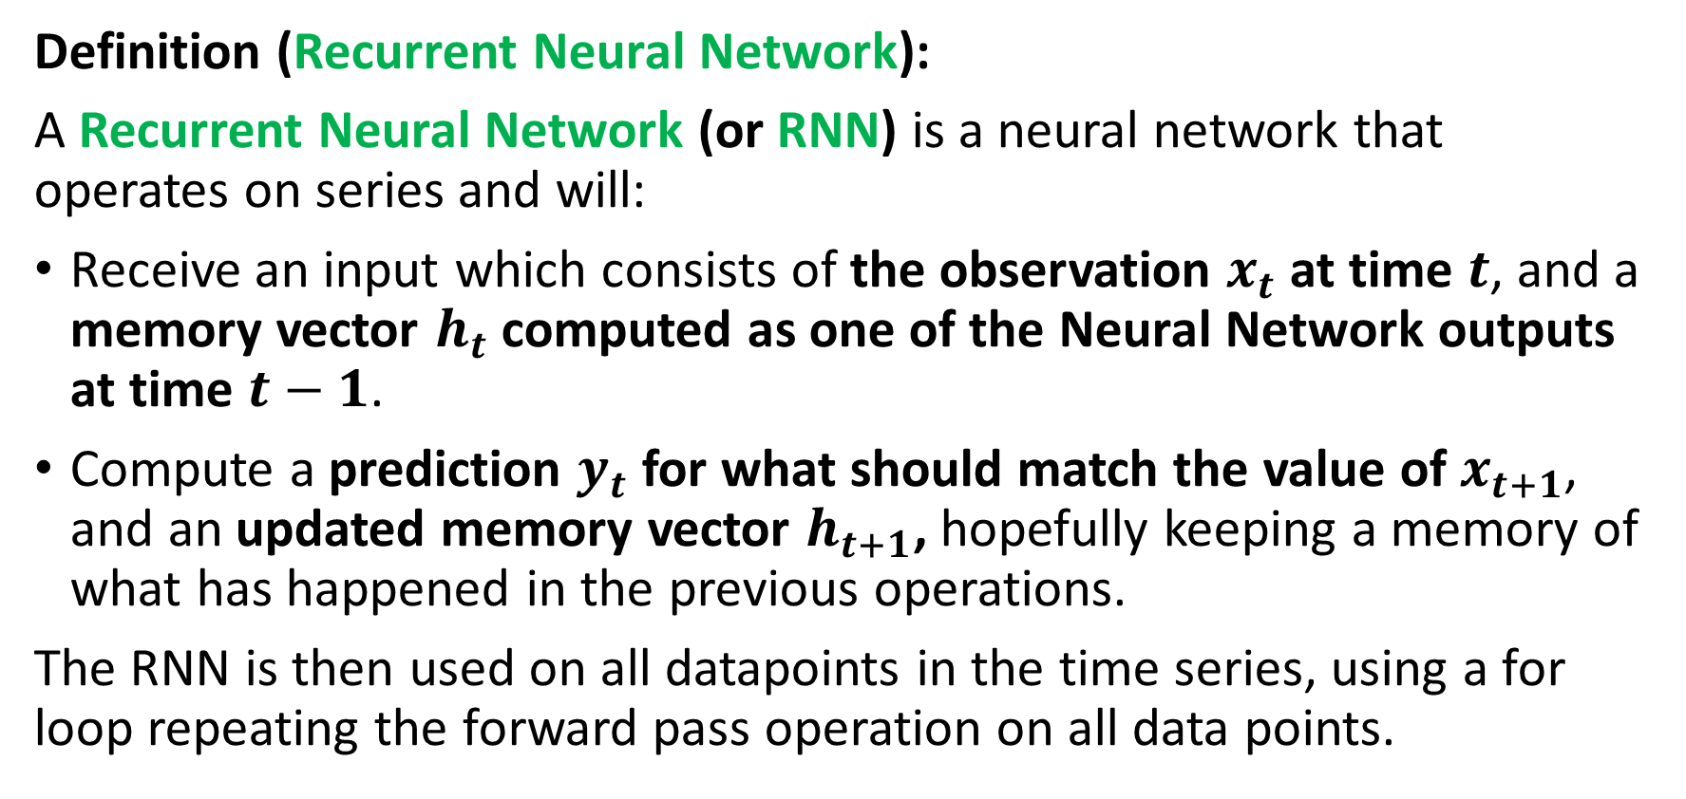
Defining a Recurrent Neural Network (RNN)
Definition (Recurrent Neural Network):
A Recurrent Neural Network (or RNN) is a neural network that operates on series and will:
Receive an input which consists of the observation $x_{t}$ at time $t$, and a memory vector $h_{t}$ computed as one of the Neural Network outputs at time $t−1$.
Compute a prediction $y_{t}$ for what should match the value of $x_{t+1}$, and an updated memory vector $h_{t+1}$, hopefully keeping a memory of what has happened in the previous operations.
The RNN is then used on all datapoints in the time series, using a for loop repeating the forward pass operation on all data points.

Slide 35
The need for memory
Neural Network prediction at $t = 1$
$$y_{1}$$
(pred. for $x_{2}$)
Neural Network prediction at $t =2$
$$y_{2}$$
(pred. for $x_{3}$)
$$x_{1}$$
$$x_{2}$$
Etc.
(use for loop on time $t$)
$$h_{0}=zeros(l)$$
$$h_{1}$$
$$h_{2}$$

Slide 36
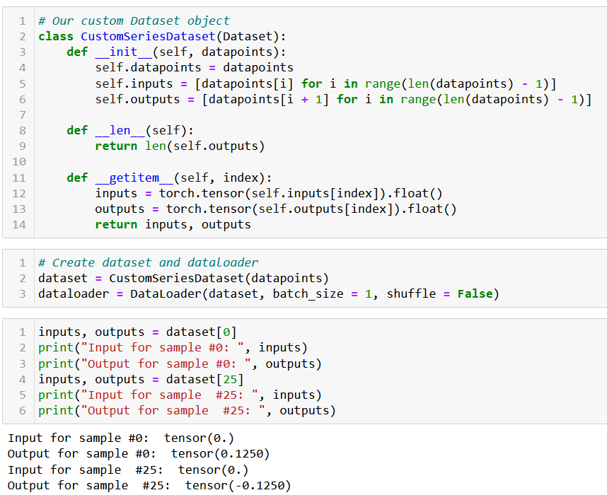

Slide 37
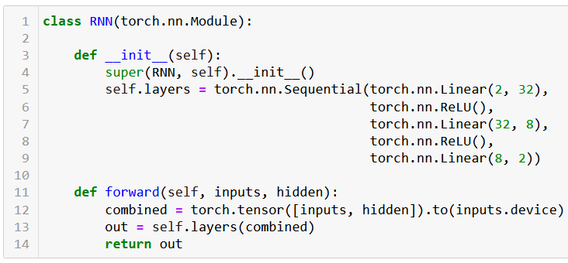
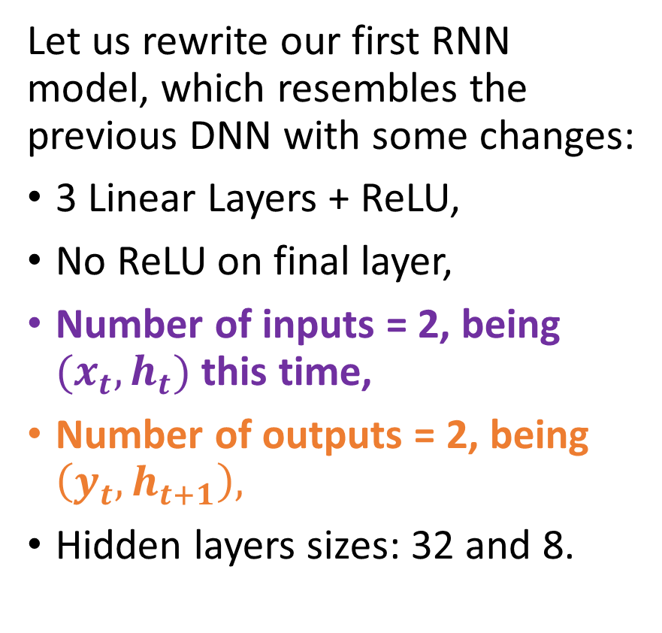
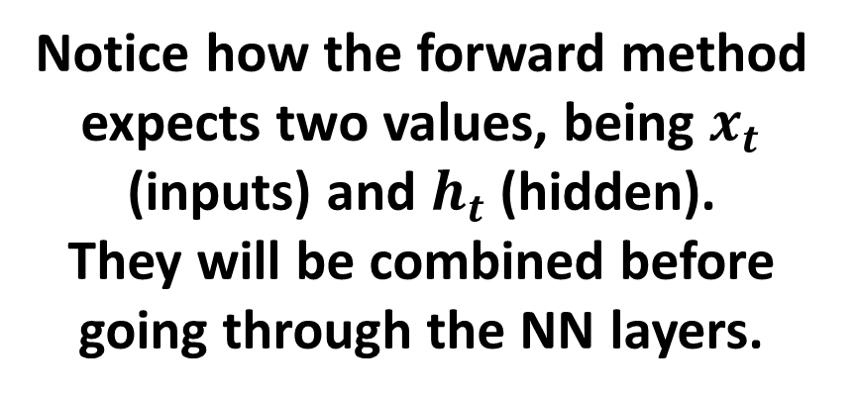
Implementing a RNN
Let us rewrite our first RNN model, which resembles the previous DNN with some changes:
3 Linear Layers + ReLU,
No ReLU on final layer,
Number of inputs = 2, being $(x_{t},h_{t})$ this time,
Number of outputs = 2, being $\left(y_{t}, h_{t+1}\right),$
Hidden layers sizes: 32 and 8.
Notice how the forward method expects two values, being $x_{t}$ (inputs) and $h_{t}$ (hidden).
They will be combined before going through the NN layers.

Slide 38
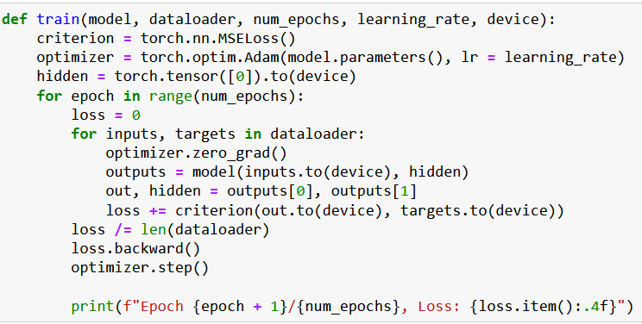
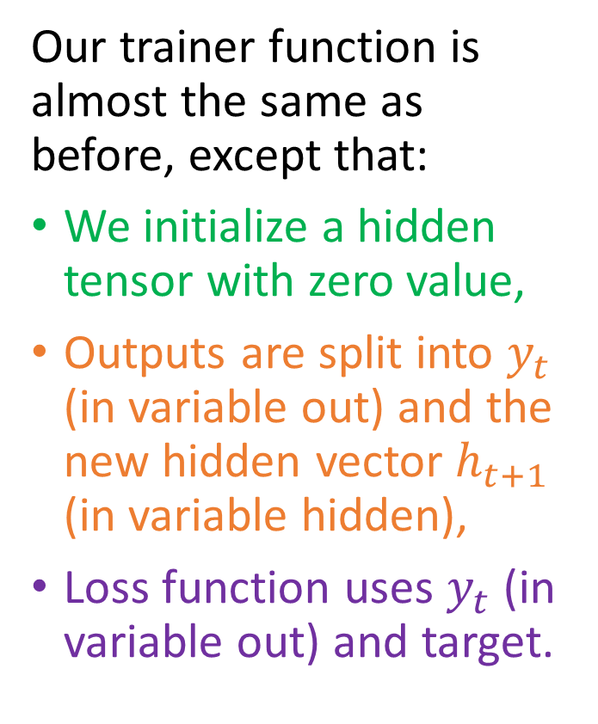
Implementing a RNN
Our trainer function is almost the same as before, except that:
We initialize a hidden tensor with zero value,
Outputs are split into $y_{t}$ (in variable out) and the new hidden vector $h_{t+1}$ (in variable hidden),
Loss function uses $y_{t}$ (in variable out) and target.

Slide 39
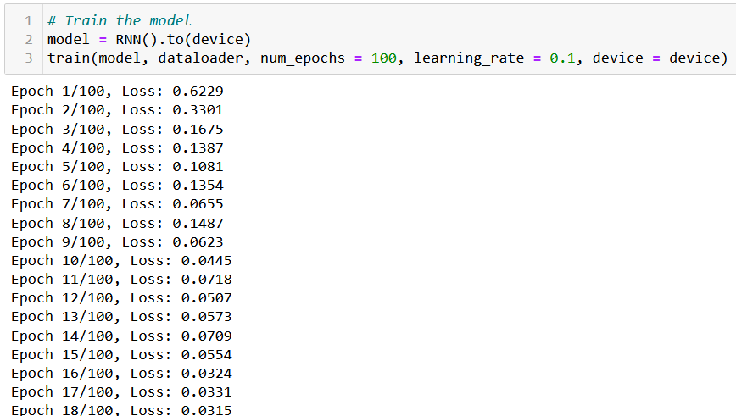
It trains!

Slide 40
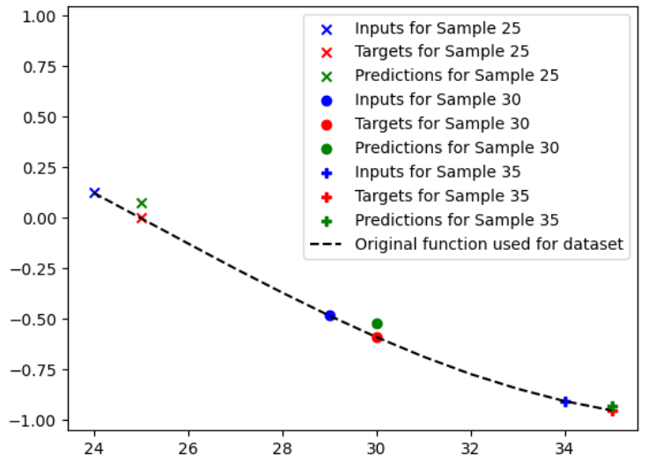
And it is not too bad at predicting!

Slide 41
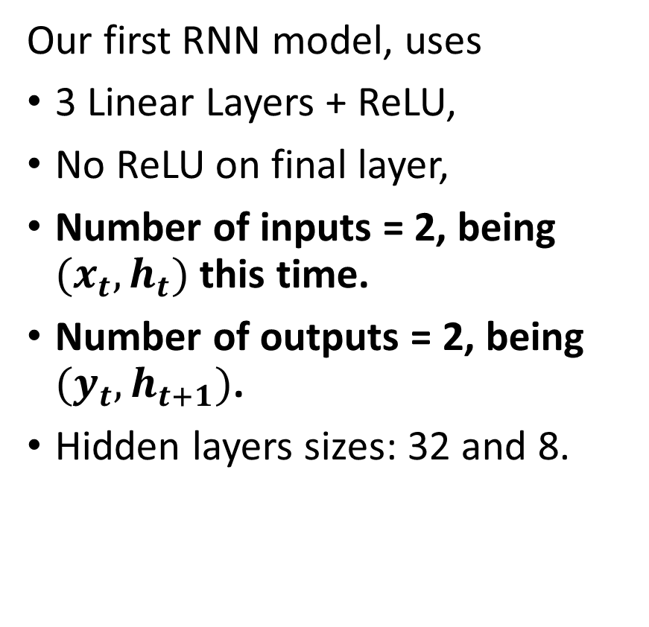
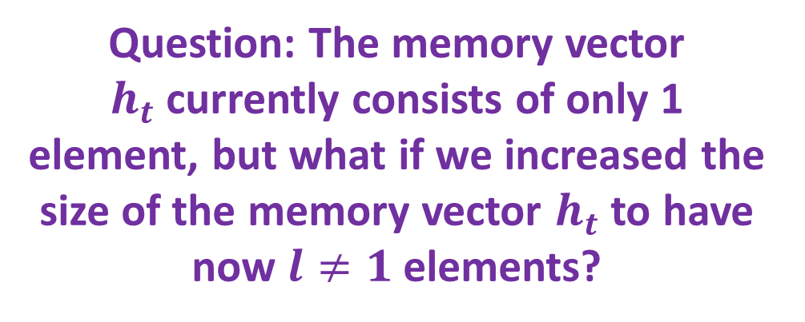
Improving our RNN
Our first RNN model, uses
3 Linear Layers + ReLU,
No ReLU on final layer,
Number of inputs = 2, being $(x_{t},h_{t})$ this time.
Number of outputs = 2, being $(y_{t}, h_{t+1})$.
Hidden layers sizes: 32 and 8.
Question: The memory vector $h_{t}$currently consists of only 1 element, but what if we increased the size of the memory vector $h_{t}$ to have now $l≠1$ elements?

Slide 42
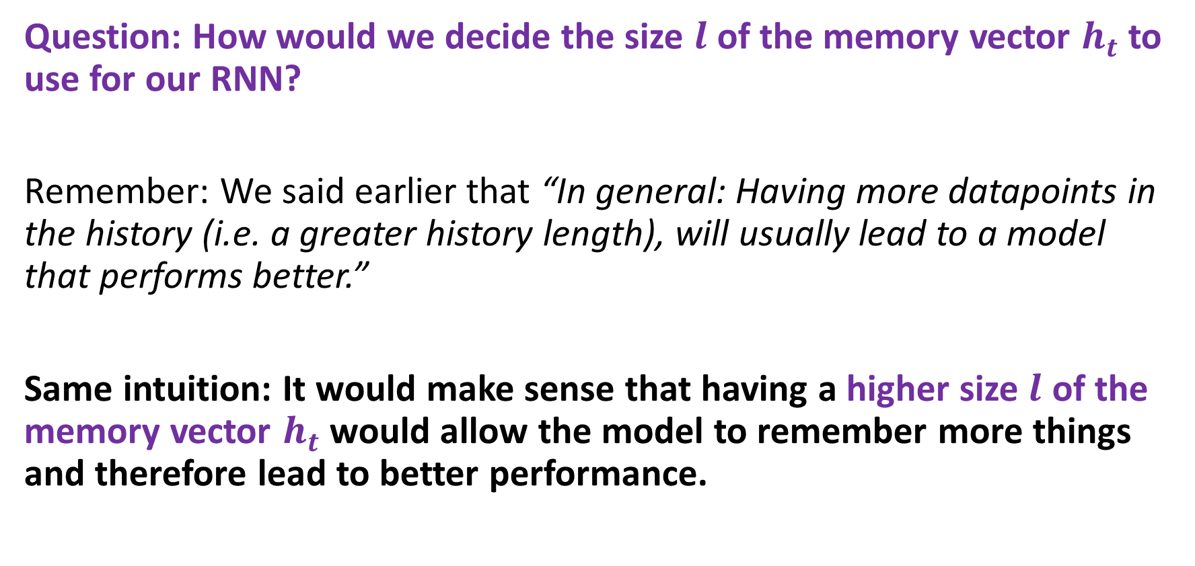
What is a good memory length then?
Question: How would we decide the size $l$ of the memory vector $h_{t}$ to use for our RNN?
Remember: We said earlier that “In general: Having more datapoints in the history (i.e. a greater history length), will usually lead to a model that performs better.”
Same intuition: It would make sense that having a higher size $l$ of the memory vector $h_{t}$ would allow the model to remember more things and therefore lead to better performance.

Slide 43
What is a good memory length then?
In practice,
Consider the time scale of the problem: The appropriate lookback length typically depends on the time scale of the problem you are trying to solve.
For example, if you are trying to predict daily stock prices, you might use a lookback length of 30 days. If you are trying to predict hourly traffic patterns, you might use a lookback length of 24 hours.
(Typically, look at seasonality and trend of your data!)
→ The more information you need in the memory, the larger the memory size of it should be.

Slide 44
What is a good memory length then?
In practice,
Balance model complexity with overfitting: Finding the optimal balance between model complexity and overfitting is a key consideration in choosing a lookback length.
A larger lookback length will capture more of the historical patterns and trends in the data, but it can also increase the complexity of the model and lead to overfitting.
A smaller lookback length may be simpler and less prone to overfitting, but it may also miss important patterns and trends in the data.
→ Tradeoff: memory length vs. underfitting/overfitting.

Slide 45
If time allows,
Will discuss about vanishing gradient problem.

Slide 46
Defining a Recurrent Neural Network (RNN)
Definition (Recurrent Neural Network):
A Recurrent Neural Network (or RNN) is a neural network that operates on series and will:
Receive an input which consists of the observation $x_{t}$ at time $t$, and a memory vector $h_{t}$ computed as one of the Neural Network outputs at time $t−1$.
Compute a prediction $y_{t}$ for what should match the value of $x_{t+1}$, and an updated memory vector $h_{t+1}$, hopefully keeping a memory of what has happened in the previous operations.
The RNN is then used on all datapoints in the time series, using a for loop repeating the forward pass operation on all data points.

Slide 47
The need for memory
Neural Network prediction at $t = 1$
$$y_{1}$$
(pred. for $x_{2}$)
Neural Network prediction at $t =2$
$$y_{2}$$
(pred. for $x_{3}$)
$$x_{1}$$
$$x_{2}$$
Etc.
(use for loop on time $t$)
$$h_{0}=zeros(l)$$
$$h_{1}$$
$$h_{2}$$

Slide 48
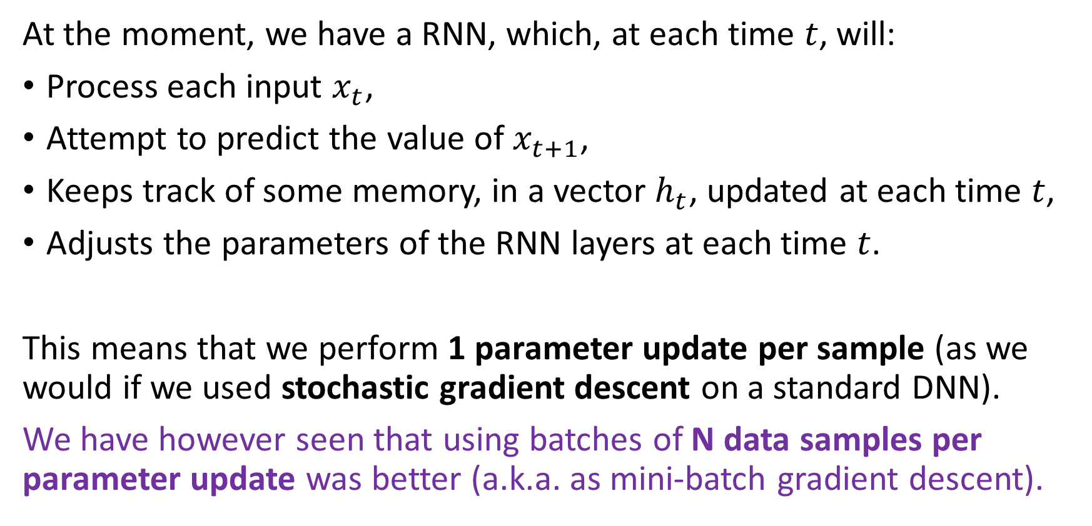
Backpropagation through time
At the moment, we have a RNN, which, at each time $t$, will:
Process each input $x_{t}$,
Attempt to predict the value of $x_{t+1}$,
Keeps track of some memory, in a vector $h_{t}$, updated at each time $t$,
Adjusts the parameters of the RNN layers at each time $t$.
This means that we perform 1 parameter update per sample (as we would if we used stochastic gradient descent on a standard DNN).
We have however seen that using batches of N data samples per parameter update was better (a.k.a. as mini-batch gradient descent).

Slide 49
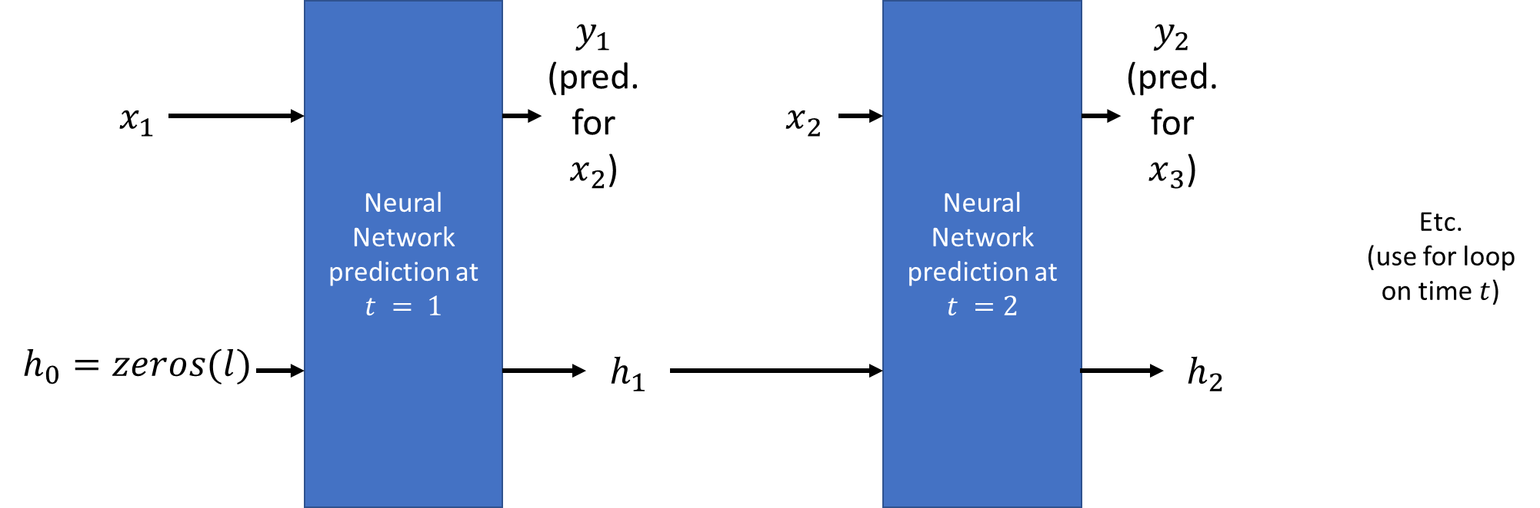
Backpropagation through time
Definition (backpropagation through time):
In order to implement a parameter update every N samples, we need to implement a backpropagation through time.
Unfold the RNN operations over time as shown,
Run predictions on N consecutive samples and keep track of loss,
Eventually perform one parameter update after N samples.
This basically allows to teach the RNN how to update the memory vectors over time.
Somewhat equivalent to a chain of successive layers, with gradient propagated through all the layers and time steps.

Slide 50
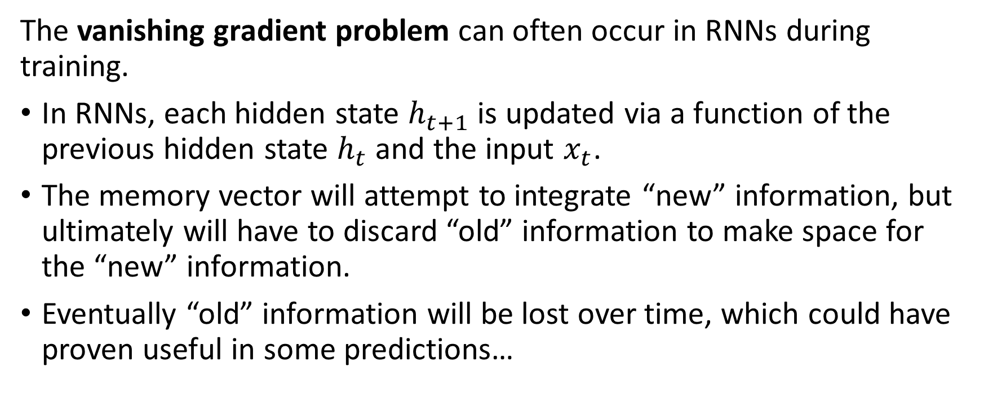
The vanishing gradient problem (part 3)
The vanishing gradient problem can often occur in RNNs during training.
In RNNs, each hidden state $h_{t+1}$ is updated via a function of the previous hidden state $h_{t}$ and the input $x_{t}$.
The memory vector will attempt to integrate “new” information, but ultimately will have to discard “old” information to make space for the “new” information.
Eventually “old” information will be lost over time, which could have proven useful in some predictions…

Slide 51

The vanishing gradient problem (part 3)
The vanishing gradient problem can often occur in RNNs during training.
In RNNs, each hidden state $h_{t+1}$ is updated via a function of the previous hidden state $h_{t}$ and the input $x_{t}$.
The memory vector will attempt to integrate “new” information, but ultimately will have to discard “old” information to make space for the “new” information.
Eventually “old” information will be lost over time, which could have proven useful in some predictions…

Slide 52
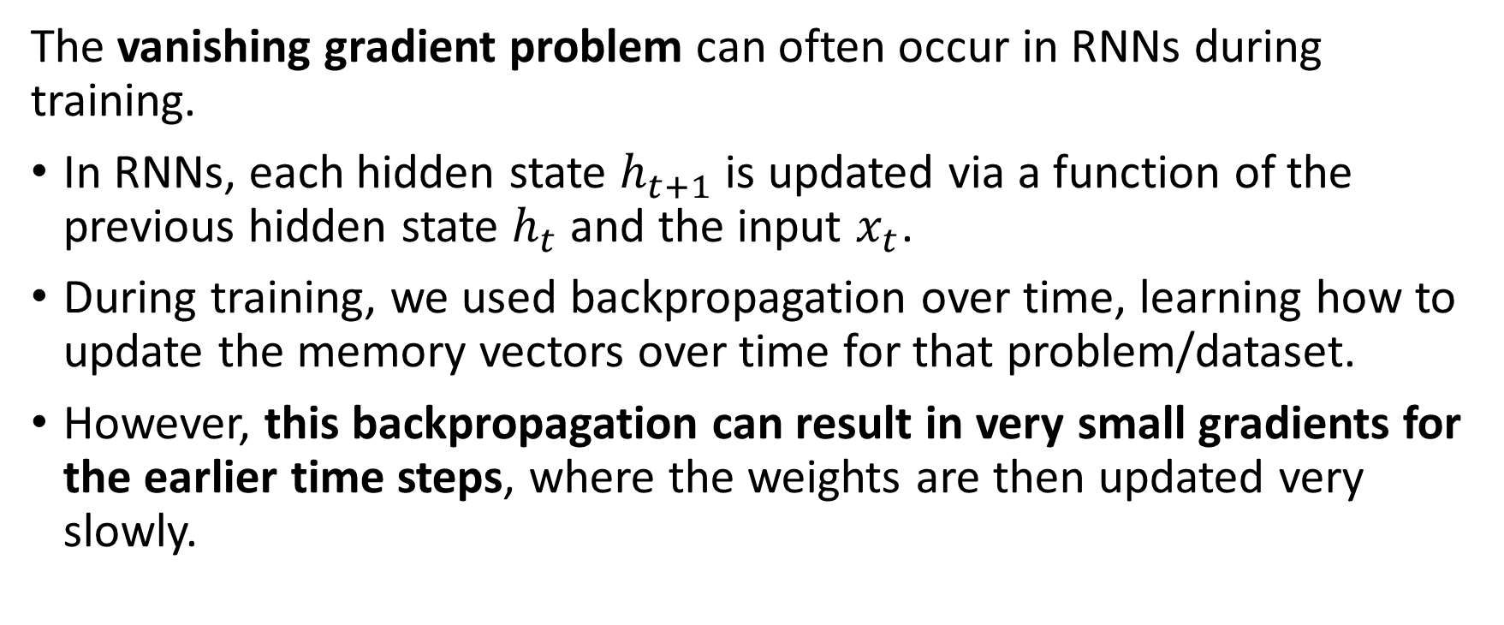
The vanishing gradient problem (part 3)
The vanishing gradient problem can often occur in RNNs during training.
In RNNs, each hidden state $h_{t+1}$ is updated via a function of the previous hidden state $h_{t}$ and the input $x_{t}$.
During training, we used backpropagation over time, learning how to update the memory vectors over time for that problem/dataset.
However, this backpropagation can result in very small gradients for the earlier time steps, where the weights are then updated very slowly.

Slide 53
The vanishing gradient problem (part 3)
The vanishing gradient problem can often occur in RNNs during training.
This can be particularly problematic for RNNs, since they are designed to handle time series data that can exhibit long-term dependencies.
The vanishing gradient problem can be particularly severe in RNNs that use activation functions that saturate, such as the hyperbolic tangent (tanh) or sigmoid functions.
Indeed, when the activation function saturates, the gradients become very small, making it difficult to propagate information through the network.

Slide 54
The vanishing gradient problem (part 3)
How to address the vanishing gradient problem in RNNs?
Several techniques have been developed to address the vanishing gradient problem in RNNs, such as using alternative activation functions, initializing the weights of the network carefully, etc.
The “best” (?) solution requires using specialized architectures like Long Short-Term Memory (LSTM) networks or Gated Recurrent Units (GRUs) to process memory.
These are designed to better handle long-term dependencies, and can help to mitigate the vanishing gradient problem.
This eventually improves the performance of RNNs on time series.

